Slide 1
Analysis Concept: Predicting locations for restaurants
ZHAW CAS Statistical Modeling
Sansar Choinyambuu

Slide 2
Problem
Location is a key to success of restaurants
Where do I open my new restaurant?
Can I use public data to answer the question?

Slide 3
Approach
Based on location characteristics predict number of successful restaurants at that location
Crawl location characteristics from OpenStreetMaps
Crawl successful restaurants from TripAdvisor
The best possible locations are:
max (predicted - actual)

Slide 4
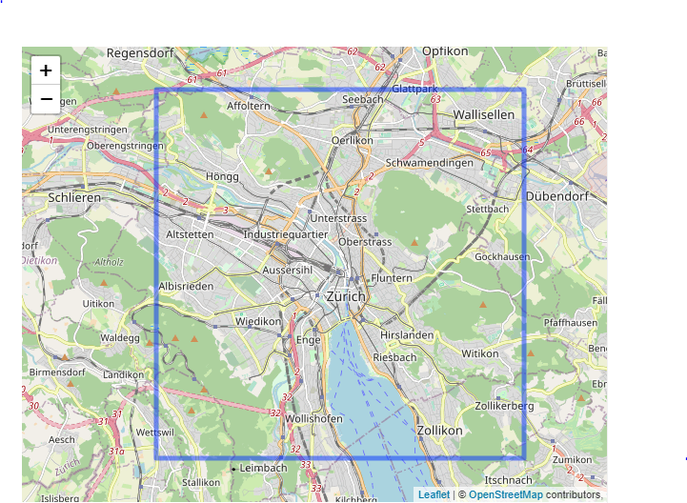
Data
Analysis done on City of Zurich
10x10 km area centred at Zurich Main Station
Location unit is 200x200m sized cell – approx 3 blocks in Wiedikon

Slide 5
Data
Open street maps [1]
Variable | Open Street Map key and value | Comment
Number of motorways | highway:{motorway}
Number of major streets | highway:{trunk, primary, secondary}
Number of minor streets | highway:{tertiary, residential}
Number of pedestrian streets | highway:{pedestrian, footway, living_street}
Number of public transport stations | public_transport:{station} | trains
Number of public transport stops | public_transport:{stop_position} | buses and trams
Number of public buildings | building:{public}
Number of residential buildings | building:{residential, apartments, house}
Number of schools | amenity:{school}
Number of universities | amenity:{univsersity, college}
Number of parking | amenity:{parking}
Number of hospitals | amenity:{hospital}
Number of entertainment | amenity:{arts_centre, cinema, theatre}
Number of leisure | leisure:{} | sports, fitness, gaming, park etc.
Number of bars | amenity:{bar, nightclub, pub, biergarten}
Number of shops | shop:{} | all kinds of shops
Number of tourism | tourism:{} | attractions, hotels etc.
[1] https://osmaxx.hsr.ch
Data extraction: https://github.com/sansar-choinyambuu/location-ai

Slide 6
Data
Reverse geocode [1]
zipcode
Trip advisor [2]
Number of successful restaurants
Successful restaurant = TripAdvisor rating is in top 30th percentile. Out of 1644 restaurants in Zurich, the top 493 are succesful.
[1] http://dev.virtualearth.net/REST/v1/Locations
[2] http://api.tripadvisor.com/api/partner/2.0
Data extraction: https://github.com/sansar-choinyambuu/location-ai

Slide 7
Model selection
Target variable is count data - Poisson model
Equidispersion not satisfied, target variable is overdispersed
Chosen model – negative binomial
lm_fit <- lm(successful_restaurants ~ ., data = locations)
variance_e_relation <- lm(log(resid(lm_fit)^2)~log(fitted(lm_fit)))
summary(variance_e_relation)
Coefficients:
Estimate Std. Error t value Pr(>|t|)
(Intercept) -0.48863 0.05504 -8.878 <2e-16 ***
log(fitted(lm_fit)) 1.78954 0.01983 90.238 <2e-16 ***

Slide 8
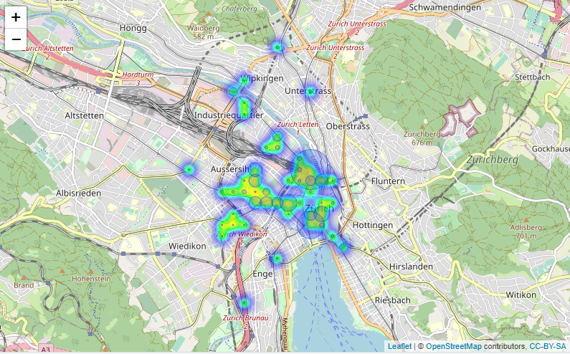
Prediction results
49 locations where model predicts more successful restaurants than there actually are [1]
[1] Out of 2500 locations

Slide 9
Outlook
Improvements
Goodness of fit test failed
Zero inflated models better suited? [1]
Cell border can skew prediction results
Competition aspects were not considered
Alternative approach
Clustering
[1] Out of 2500 locations 2238 have no successful restaurants

